Slide 2

Ypp 4
bbv Software Services AG | Date: 25/08/2025

Slide 3
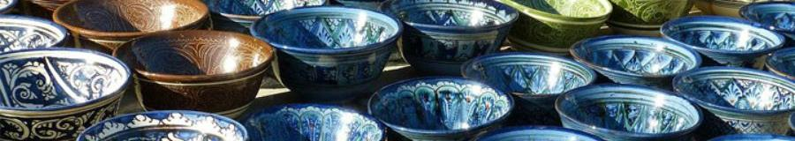
The Art of Ceramics and Jewelry in Vietnamese History
Presented by: Luong Tuyet Mi – Intern, BBV Vietnam | Date: 25/08/2025

Slide 4
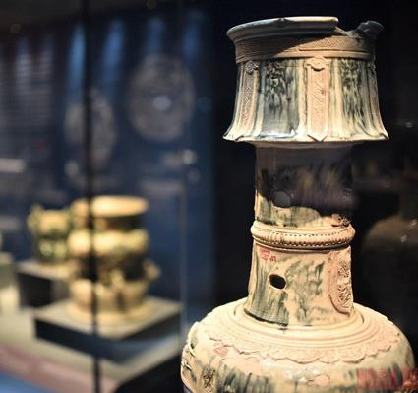
Agenda
Introduction
Prehistoric Period
Champa & Óc Eo Cultures
Lý & Trần Dynasties
Lê & Nguyễn Dynasties
Artistic and Cultural Values
Q & A

Slide 5

Introduction
Exploring cultural treasures through historical artifacts

Slide 6
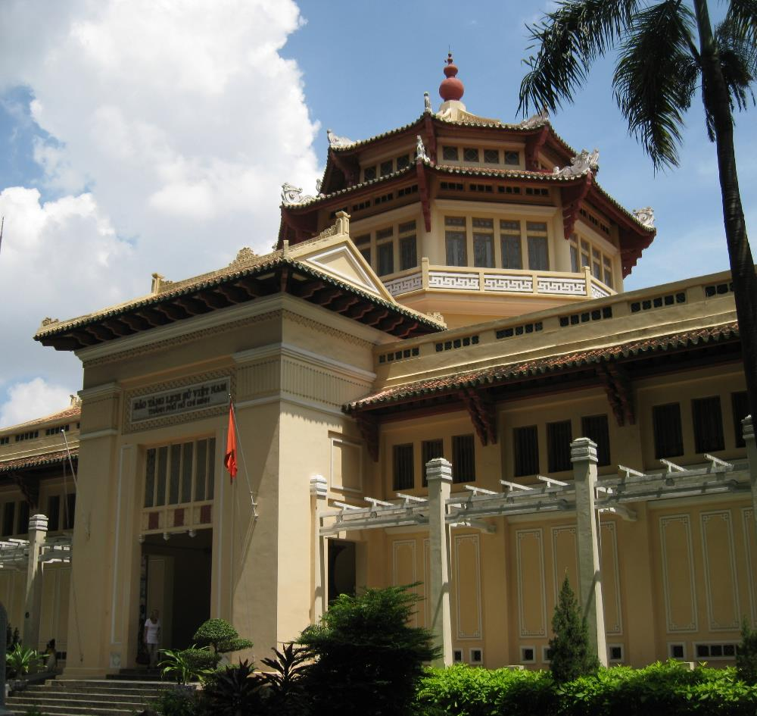
Introduction
Vietnamese history reflected in art and artifacts
Ceramics and jewelry: everyday objects, yet cultural symbols
Preserved at the History Museum of Ho Chi Minh City

Slide 7
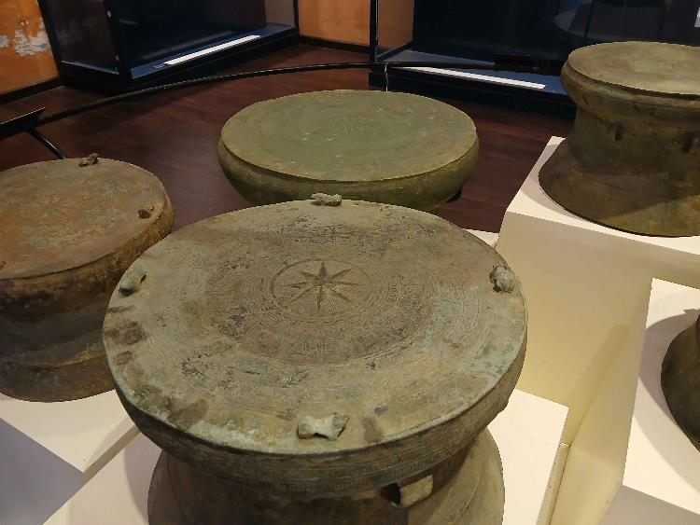
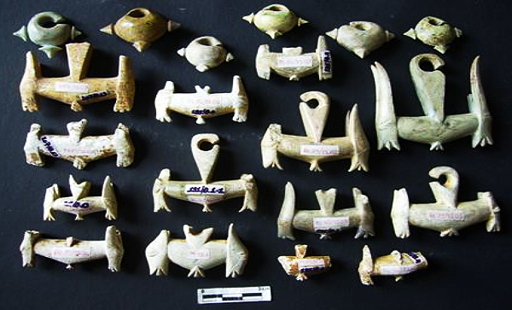
Prehistoric Period (2,000–3,000 years ago)
Early pottery: handmade, simple shapes, geometric patterns
Ornaments: stone beads, jade earrings, shell necklaces
Cultures: Đông Sơn (bronze drums), Sa Huỳnh (ear ornaments)

Slide 8
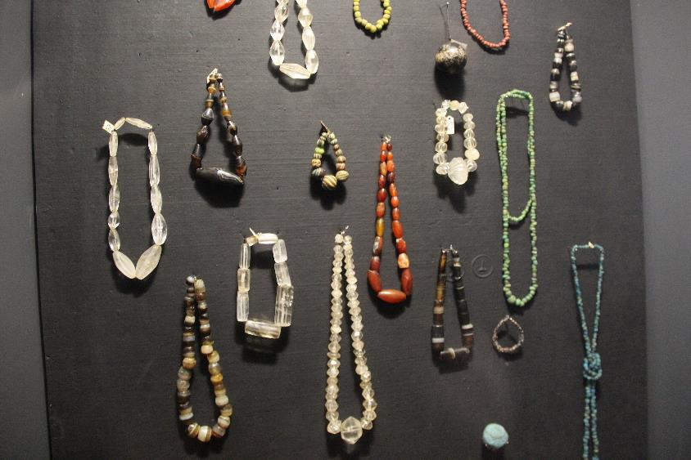
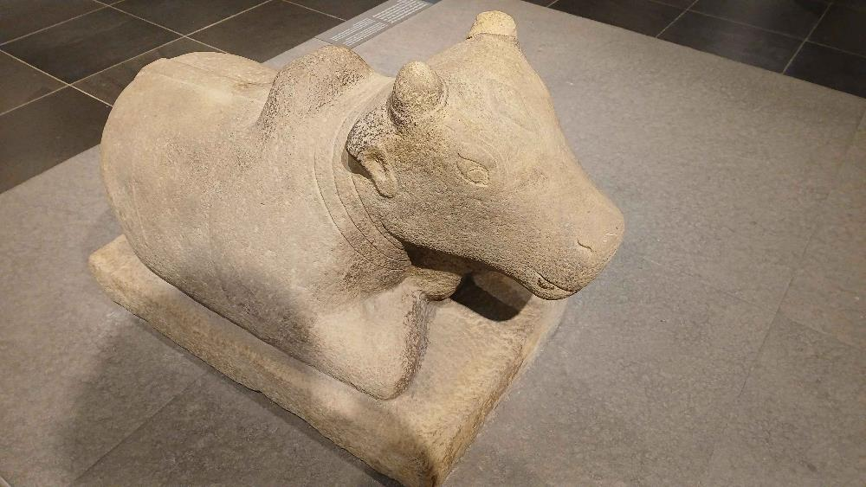
Champa & Óc Eo Cultures (1st–9th centuries)
Ceramics: simple, functional, influenced by India & Buddhism
Jewelry: gold rings, gemstone pendants, large ear ornaments
Highlights: Óc Eo gold jewelry, Champa sculptures

Slide 9
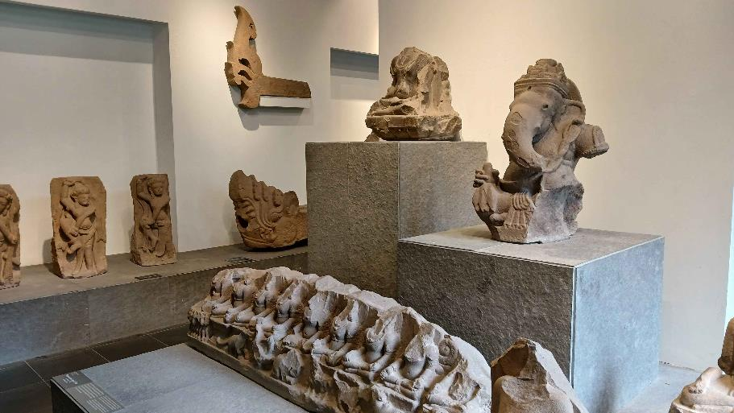
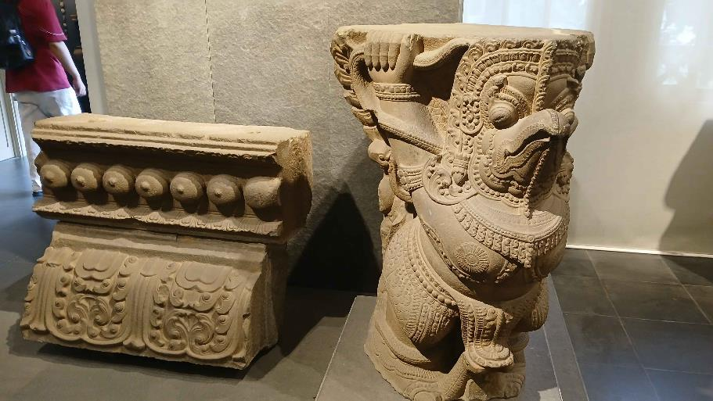
Champa & Óc Eo Cultures (1st–9th centuries)

Slide 10
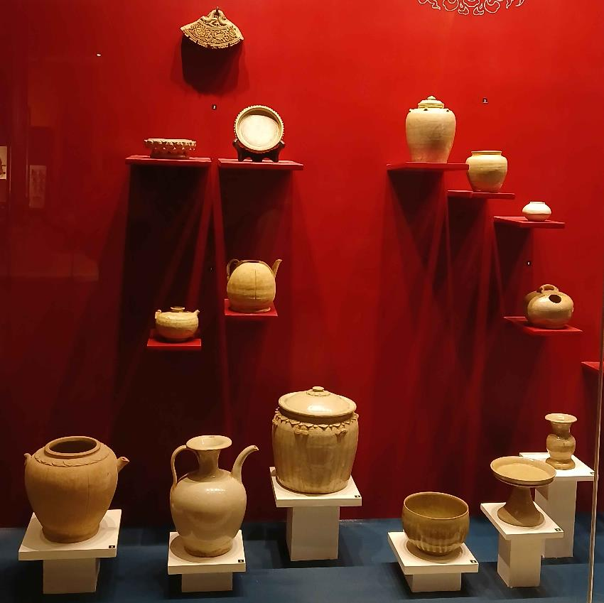
Lý & Trần Dynasties (11th–14th centuries)
Ceramics: celadon glaze, white-and-blue, lotus & dragon motifs
Jewelry: gold and silver, delicate carvings, pearl ornaments
Strong influence of Buddhism → lotus and phoenix designs

Slide 11
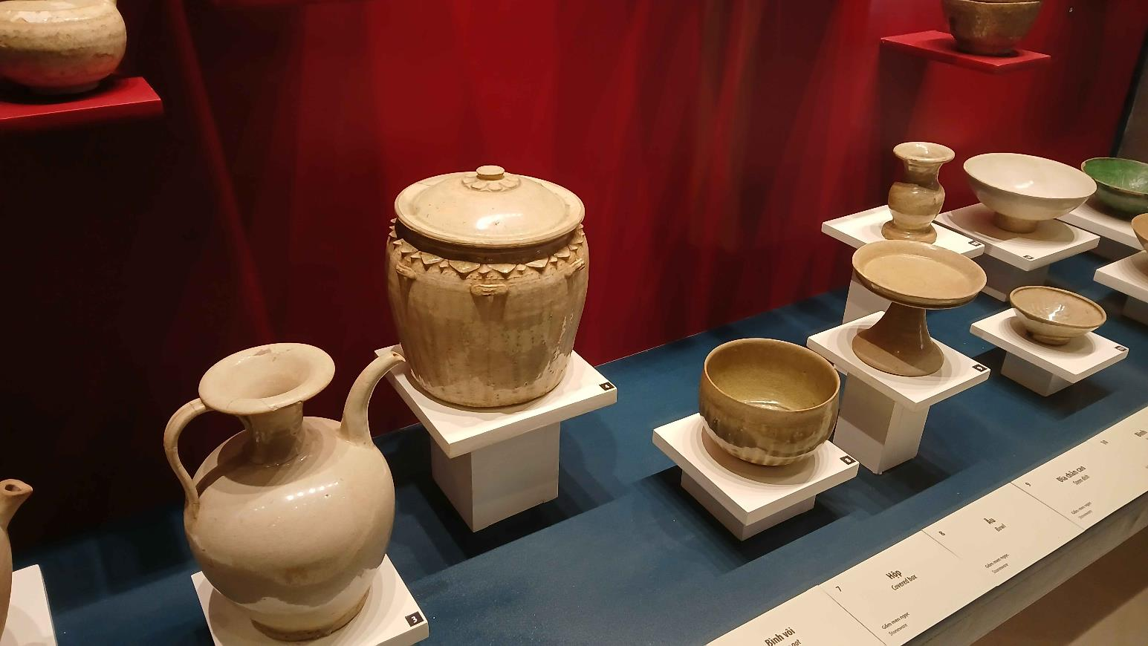
Lý & Trần Dynasties (11th–14th centuries)

Slide 12
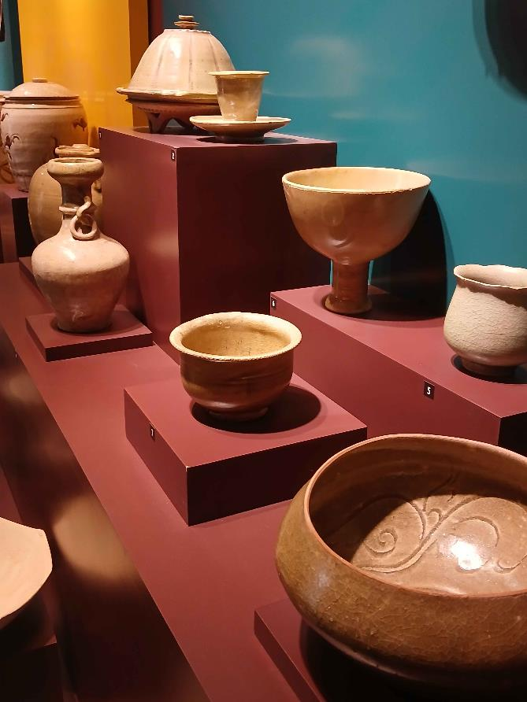
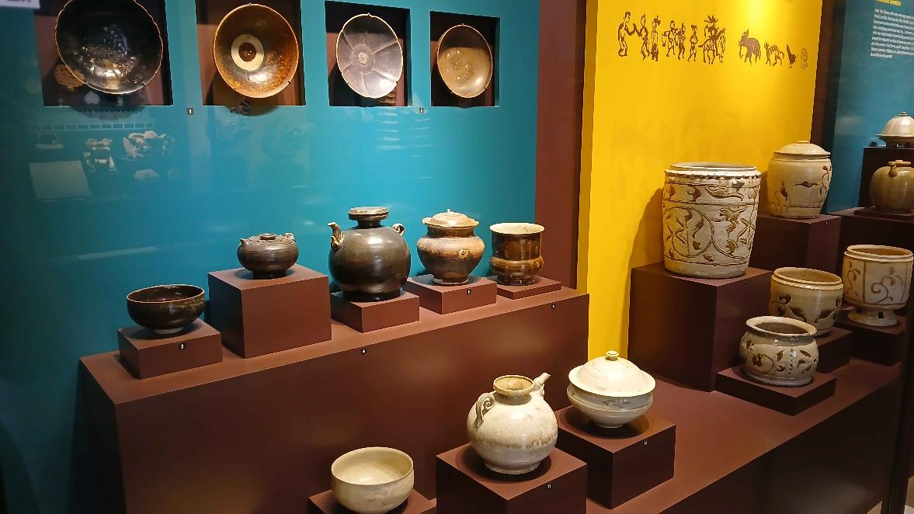
Lý & Trần Dynasties (11th–14th centuries)

Slide 13
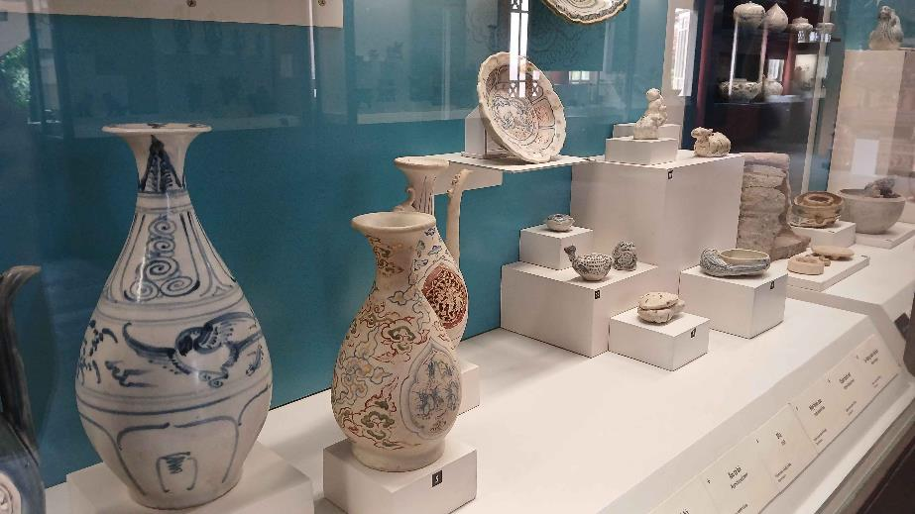
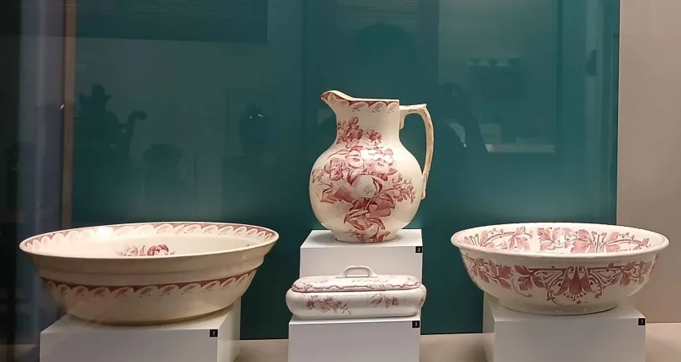
Lê & Nguyễn Dynasties (15th–19th centuries)
Ceramics: blue-and-white porcelain, brown-glazed ware, imperial wares
Jewelry: rings, hairpins, jade pendants, royal ornaments
Influences: China and Europe → more diverse designs

Slide 14
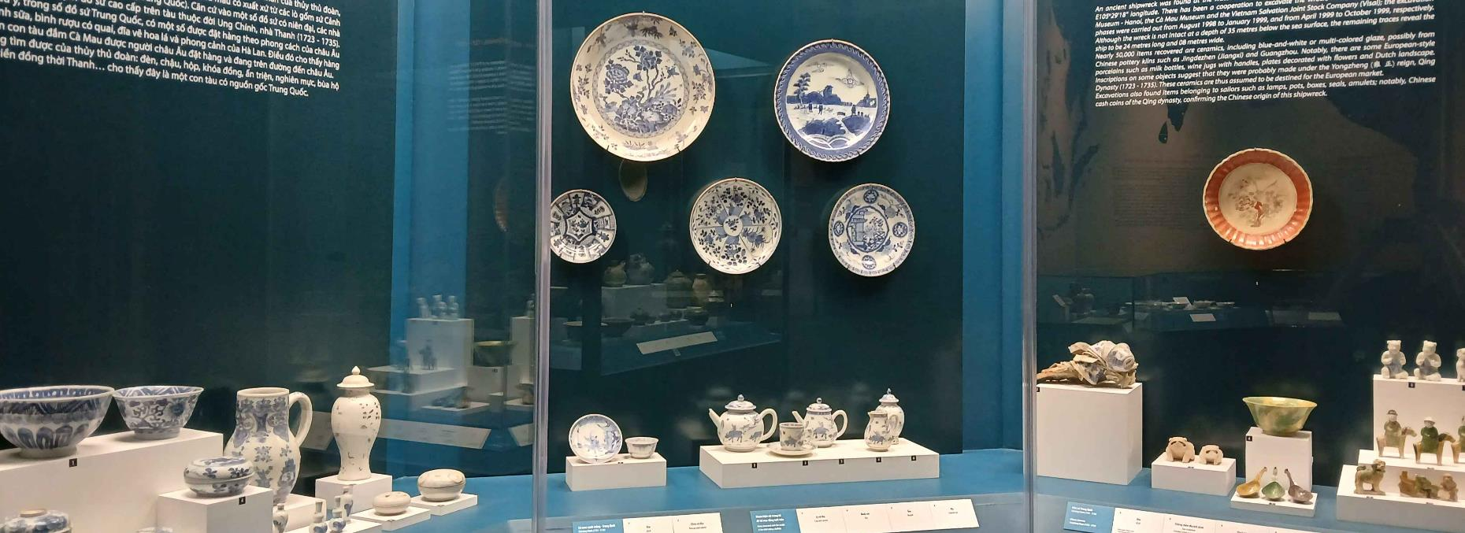
Artistic & Cultural Values
Creativity & Craftsmanship – advanced techniques over centuries
Symbolism – reflect beliefs, religion, and power
Identity – connect past and present through cultural heritage

Slide 15
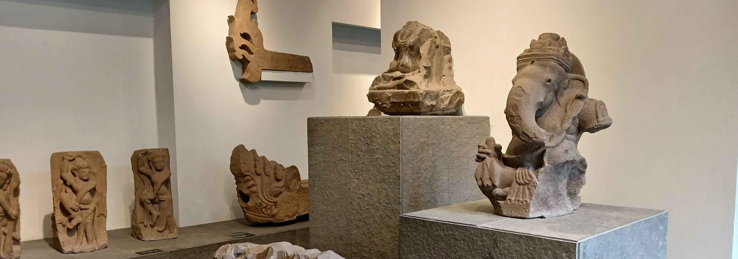
Questions & Discussion
Thank you for listening

